Slide 1
Module 2, Section 2: AWS Core Services - Storage
© 2018, Amazon Web Services, Inc. or its Affiliates. All rights reserved.
Notes:
Welcome to Module 2, Section 2 – AWS Core Services - Storage.

Slide 2
What’s In This Module
Module 2, Section 2 – Core Services - Storage:
Part 1: Amazon Elastic Block Store (Amazon EBS)
Part 2: Amazon Simple Storage Service (Amazon S3)
Part 3: Amazon Elastic File System (Amazon EFS)
Part 4: Amazon Glacier
Notes:
Cloud storage is typically more reliable, scalable, and secure than traditional on-premises storage systems. Cloud storage is a critical component of cloud computing, holding the information used by applications. Big data analytics, data warehouses, Internet of Things (IoT), databases, and backup and archive applications all rely on some form of data storage architecture.
In this module, we’ll explore Amazon Elastic Block Store (or Amazon EBS), Amazon Simple Storage Service (or Amazon S3), Amazon Elastic File System (or Amazon EFS) and Amazon Glacier.

Slide 3
Module Objectives
Discuss key concepts related to storage:
Understand the differences between different types of storage
Review basic pricing that differentiates the storage solutions
Notes:
The goal of this module is to discover key concepts related to storage. You’ll understand the different types of storage resources that are available and review the different pricing options, so you understand how different choices impact your solution cost.

Slide 4
Section 2: Introduction to Storage Services
Notes:
Introducing Section 2: An Introduction to Storage Services.

Slide 5









Core AWS Services
Amazon S3
Amazon EBS
Amazon
EFS
Amazon Glacier
Amazon
VPC
Amazon EC2
Storage
AWS IAM
Amazon RDS
Amazon DynamoDB
Database
Notes:
It is not surprising that storage is another AWS core service. There are three broad categories of storage: instance store ("ephemeral"), Amazon EBS, and Amazon S3.
Instance store, or ephemeral storage, is a temporary storage that it is added to your Amazon EC2 instance.
Amazon EBS is persistent, mountable storage, which can be mounted as a device to an Amazon EC2 instance. Amazon EBS can only be mounted to an Amazon EC2 instance within the same Availability Zone.
Similar to Amazon EBS, Amazon S3 is persistent storage; however, it can be accessed from anywhere.

Slide 6
Part 1: Amazon Elastic Block Store (Amazon EBS)
Notes:
Amazon Elastic Block Store (or Amazon EBS) is an AWS block storage system that is best used for storing persistent data. Amazon EBS provides highly available block level storage volumes for use with Amazon EC2 instances.

Slide 7

Storage
Amazon Elastic Block Store (Amazon EBS)
Notes:
Amazon EBS provides persistent block storage volumes for use with Amazon EC2 instances in the cloud. Persistent storage is any data storage device that retains data after power to that device is shut off. It is also sometimes referred to as non-volatile storage.
Each Amazon EBS volume is automatically replicated within its Availability Zone to protect you from component failure, offering high availability and durability. Amazon EBS volumes offer the consistent and low-latency performance needed to run your workloads.
With Amazon EBS, you can scale your usage up or down within minutes – all while paying a low price for only what you provision.

Slide 8


AWS Storage Options: Block vs. Object Storage
What if you want to change one character in a 1-GB file?
Block Storage
Object Storage
Change one block (piece of the file)
that contains the character
Entire file must be updated
Notes:
What if you want to change one character in a 1 gigabyte file? With block storage, you only need to change the block that contains the character. With object storage, the entire file must be updated.
One of the critical concepts to understanding the differences between some storage types is whether they offer "block-level" storage or "object-level" storage.
This difference has a major impact on the throughput, latency, and cost of your storage solution. Block storage solutions are typically faster and use less bandwidth, but cost more than object-level storage.

Slide 9
Amazon EBS
Amazon EBS allows you to create individual storage volumes and attach them to an Amazon EC2 instance.
Amazon EBS offers block-level storage.
Volumes are automatically replicated within its Availability Zone.
Can be backed up automatically to Amazon S3.
Uses:
Boot volumes and storage for Amazon EC2 instances
Data storage with a file system
Database hosts
Enterprise applications
Notes:
Amazon EBS allows you to create individual storage volumes and attach them to an Amazon EC2 instance. Amazon EBS offers block-level storage with volumes automatically replicated within its Availability Zone to provide durable, detachable, block-level storage (such as an external hard drive) for your Amazon EC2 instances. Because they are directly attached to the instances, they can provide extremely low latency between where the data is stored and where it might be used on the instance.
For this reason, they can be used to run a database with an Amazon EC2 instance. Amazon EBS volumes can also be used to back up your instances into Amazon Machine Images (or AMIs), which are stored in Amazon S3 and can be reused to create new Amazon EC2 instances later.
Uses include:
Boot volumes and storage for Amazon EC2 instances
Data storage with a file system
Database hosts
Enterprise applications

Slide 10
Amazon EBS Volume Types
 | Solid-State Drives (SSD) |  | Hard Disk Drives (HDD)
 | General Purpose | Provisioned IOPS | Throughput-Optimized | Cold
Max volume size | 16 TiB | 16 TiB | 16 TiB | 16 TiB
Max IOPS/volume | 16,000 | 64,000 | 500 | 250
Max throughput/volume | 250 MiB/s | 1,000 MiB/s | 500 MiB/s | 250 MiB/s
Notes:
Matching the correct technology to your workload is a key best practice for reducing storage costs. Provisioned IOPS SSD-backed Amazon EBS volumes can give you the highest performance; however, if your application doesn't require or won't use performance that high, one of the lower-cost options might be a better solution.
Select the link to learn more.
http://docs.aws.amazon.com/AWSEC2/latest/UserGuide/EBSVolumeTypes.html.

Slide 11
Amazon EBS Volume Types
 | Solid-State Drives (SSD) |  | Hard Disk Drives (HDD)
 | General Purpose | Provisioned IOPS | Throughput-Optimized | Cold
Use Cases | Recommended for most workloads System boot volumes Virtual desktops Low-latency interactive apps Development and test environments | Critical business applications that require sustained IOPs performance, or more than 16,000 IOPS or 250 MiB/s of throughput per volume Large database workloads | Streaming workloads requiring consistent, fast throughput at a low price Big data Data warehouses Log processing Cannot be a boot volume | Throughput-oriented storage for large volumes of data that is infrequently accessed Scenarios where the lowest storage cost is important Cannot be a boot volume
Notes:
An Amazon EBS volume is a durable, block-level storage device that you can attach to a single EC2 instance. You can use EBS volumes as primary storage for data that requires frequent updates, such as the system drive for an instance or storage for a database application. You can also use them for throughput-intensive applications that perform continuous disk scans. EBS volumes persist independently from the running life of an EC2 instance.
For more information on EBS volumes, select the link.
https://docs.aws.amazon.com/AWSEC2/latest/UserGuide/EBSVolumes.html

Slide 12



Amazon EBS
Snapshots:
Point-in-time snapshots
Recreate a new volume at any time
Encryption:
Encrypted Amazon EBS volumes
No additional cost
Elasticity:
Increase capacity
Change to different types
Notes:
To provide an even higher level of data durability, Amazon EBS gives you the ability to create point-in-time snapshots of your volumes, and AWS allows you to recreate a new volume from a snapshot at any time. Share snapshots or even copy snapshots to different AWS Regions for even greater disaster recovery (DR) protection. You can, for example, encrypt and share your snapshots from Virginia to Tokyo.
You could also have encrypted Amazon EBS volumes at no additional cost. The encryption occurs on the Amazon EC2 side, so the data moving between the Amazon EC2 instance and the Amazon EBS volume inside AWS data centers will be encrypted in transit.
As your company grows, the amount of data stored on your Amazon EBS volumes will likely also grow. Amazon EBS volumes have the ability to increase capacity and change to different types, meaning that you can change from hard disk to SSD or increase from a 50-gigabyte volume to a 16-terabyte volume. For example, you can do this resize operation on the fly without needing to stop the instances.

Slide 13
Amazon EBS: Volumes and IOPS
Volumes:
Amazon EBS volumes persist independently from the instance.
All volume types are charged by the amount provisioned per month.
Input Output Operations per Second (IOPS):
General Purpose (SSD)
Charged by the amount your provision in GB per month until storage is released
Magnetic
Charged by the number of requests to volume
Provisioned IOPS (SSD)
Charged by the amount you provision in IOPS (by % of day / month used)
Notes:
When you begin to estimate the cost for Amazon EBS, you need to consider the following:
Volumes – Volume storage for all Amazon EBS volume types is charged by the amount you provision in GB per month, until you release the storage.
Input Output Operations per Second (IOPS) – Input/output (I/O) is included in the price of General Purpose (SSD) volumes, while for Amazon EBS Magnetic volumes, I/O is charged by the number of requests you make to your volume. With Provisioned IOPS (SSD) volumes, you are also charged by the amount you provision in IOPS (multiplied by the percentage of days you provision for the month).

Slide 14
Amazon EBS: Snapshots and Data Transfer
Snapshots:
Added cost of Amazon EBS snapshots to Amazon S3 is per GB-month of data stored.
Data Transfer:
Inbound data transfer is free.
Outbound data transfer charges are tiered.
Notes:
Snapshots – Amazon EBS provides the ability to back up snapshots of your data to Amazon S3 for durable recovery. If you opt for Amazon EBS snapshots, the added cost is per GB-month of data stored.
Data Transfer – Take into account the amount of data transferred out of your application. Inbound data transfer is free, and outbound data transfer charges are tiered.

Slide 15
In Review
Amazon EBS Features:
Persistent and customizable block storage for Amazon EC2
HDD and SSD types
Replicated in the same Availability Zone
Easy and transparent encryption
Elastic volumes
Back up using snapshots
Notes:
Amazon EBS provides block level storage volumes for use with Amazon EC2 instances. Amazon EBS volumes are off-instance storage that persists independently from the life of an instance. They are analogous to virtual disks in the cloud. Amazon EBS provides three volume types: General Purpose (SSD), Provisioned IOPS (SSD), and Magnetic.
The three volume types differ in performance characteristics and cost, so you can choose the right storage performance and price for the needs of your applications.
Additional benefits include replication in the same Availability Zone, easy and transparent encryption, elastic volumes and back up using snapshots.
To learn more about Amazon EBS, select the link.
https://aws.amazon.com/ebs/.

Slide 16
Amazon EBS Demo
Notes:
Please review the demonstration: Amazon Elastic Block Store Console Demo.
This video demonstration can be found in the learning management system.

Slide 17
Module 2, Section 2, Lab 2: Working with Amazon EBS
Notes:
Introducing Section 2, Lab 2: Working with Amazon EBS.

Slide 18
Lab 2 Scenario
This lab focuses on Amazon EBS, a key underlying storage mechanism for Amazon EC2 instances.
In this lab, you will create an Amazon EBS volume, attach it to an instance, apply a file system to the volume, and then take a snapshot backup.
Amazon EBS
Notes:
Amazon EBS provides persistent block storage volumes for use with Amazon EC2 instances in the AWS cloud. Each Amazon EBS volume is automatically replicated within its Availability Zone to protect you from component failure, offering high availability and durability.
After completing this lab, you will be able to:
Create an Amazon EBS volume
Attach the volume to an instance
Configure the instance to use the virtual disk
Create an Amazon EBS snapshot
Restore the snapshot
This lab will take approximately 45 minutes.

Slide 19


Lab 2: Tasks
Create a new EBS volume.
Attach the volume to an Amazon EC2 instance.
Create and configure your file system.
Create a snapshot.
Amazon EBS
Amazon EC2 Instance
Amazon EBS
snapshot
Notes:
Take a moment to complete the lab:
Create a new EBS volume.
Attach the volume to an Amazon EC2 instance.
Create and configure your file system.
Create a snapshot.

Slide 20

Lab 2: Final Product
Attached
Created
Amazon EC2 Instance
Amazon EBS
Snapshot
In this lab, you:
Created an Amazon EBS volume
Attached that volume to an instance
Configured the instance to use the virtual disk
Created an Amazon EBS snapshot
Restored the snapshot
~ 45 minutes
~ 45 minutes
Notes:
In this lab, you:
Created an Amazon EBS volume
Attached that volume to an instance
Configured the instance to use the virtual disk
Created an Amazon EBS snapshot
Restored the snapshot

Slide 21
Part 2: Amazon Simple Storage Service (Amazon S3)
Notes:
Introducing Part 2: Amazon Simple Storage Service (Amazon S3).
Companies today need the ability to simply and securely collect, store, and analyze their data at a massive scale. Amazon S3 is object storage built to store and retrieve any amount of data from anywhere - web sites and mobile apps, corporate applications, and data from internet of things sensors or devices.

Slide 22

Storage
Amazon Simple Storage Service (Amazon S3)
Notes:
Amazon S3 is object-level storage, which means that if you want to change a part of a file, you have to make the change and then re-upload the entire modified file. Amazon S3 stores data as objects within resources called buckets.
Let’s take a closer look Amazon S3.

Slide 23
Amazon S3
Managed cloud storage solution designed to scale seamlessly and provide 99.999999999% durability.
Store as many objects as you want.
Bucket names must be unique across all existing bucket names in Amazon S3.
Amazon S3 cannot be used as a bootable drive.
Data is stored redundantly.
Access Amazon S3 with the AWS Management Console, one of the Software Development Kits (SDKs), or a third-party solution.
Object uploads or deletes can trigger notifications, workflows, or even scripts.
Data in transit and at rest can be encrypted automatically.
Storage class analysis (Amazon S3 Analytics) to analyze storage access patterns and transition the right data to the right storage class.
Notes:
Amazon S3 is a managed cloud storage solution designed to scale seamlessly and provide over 99.9% durability. You can store as many objects as you want within a bucket, and write, read, and delete objects in your bucket. Bucket names are universal and must be unique across all existing bucket names in Amazon S3. Objects can be up to 5 terabytes in size. By default, data in Amazon S3 is stored redundantly across multiple facilities and multiple devices in each facility.
Amazon S3 is a fully managed storage service that provides a simple API for storing and retrieving data. This means that the data you store in Amazon S3 isn't associated with any particular server, and you don't have to manage any infrastructure yourself. You can put as many objects into Amazon S3 as you want. Amazon S3 holds trillions of objects and regularly peaks at millions of requests per second.
Objects can be almost any data file, such as images, videos, or server logs. Since Amazon S3 supports objects as large as several terabytes in size, you could even store database snapshots as objects. Amazon S3 also provides low-latency access to the data over the internet by HTTP or HTTPS, so you can retrieve data anytime from anywhere. You can also access Amazon S3 privately through a virtual private cloud endpoint. You get fine-grained control over who can access your data using identity and access management policies, S3 bucket policies, and even per-object access control lists.
By default, none of your data is shared publicly. You can also encrypt your data in transit and choose to enable server-side encryption on your objects.
Amazon S3 can be accessed via the web-based AWS Management Console, programmatically via the API and SDKs, or with third-party solutions, which use the API/SDKs.
Amazon S3 includes event notifications that allow you to set up automatic notifications when certain events occur, such as an object being uploaded to or deleted from a specific bucket. Those notifications can be sent to you, or they can be used to trigger other processes, such as AWS Lambda scripts.
With storage class analysis, you can analyze storage access patterns and transition the right data to the right storage class. This new Amazon S3 Analytics feature automatically identifies the optimal lifecycle policy to transition less frequently accessed storage to Amazon S3 Standard – Infrequent Access (S3 Standard-IA). You can configure a storage class analysis policy to monitor an entire bucket, a prefix, or object tag.
Once an infrequent access pattern is observed, you can easily create a new lifecycle age policy based on the results. Storage class analysis also provides daily visualizations of your storage usage in the AWS Management Console. You can export these to an S3 bucket to analyze using the business intelligence tools of your choice, such as Amazon QuickSight.

Slide 24
Amazon S3 Storage Classes
Amazon S3 offers a range of object-level storage classes designed for different use cases:
S3 Standard
S3 Intelligent-Tiering
S3 Standard-Infrequent Access (S3 Standard-IA)
S3 One Zone-Infrequent Access (S3 One Zone-IA)
Amazon S3 Glacier (S3 Glacier)
Amazon S3 Glacier Deep Archive (S3 Glacier Deep Archive)
Notes:
Amazon S3 offers a range of object-level storage classes designed for different use cases. These include:
S3 Standard: S3 Standard offers high durability, availability, and performance object storage for frequently accessed data. Because it delivers low latency and high throughput, S3 Standard is appropriate for a wide variety of use cases, including cloud applications, dynamic websites, content distribution, mobile and gaming applications, and big data analytics.
S3 Intelligent-Tiering: The S3 Intelligent-Tiering storage class is designed to optimize costs by automatically moving data to the most cost-effective access tier, without performance impact or operational overhead. It works by storing objects in two access tiers: one tier that is optimized for frequent access and another lower-cost tier that is optimized for infrequent access. For a small monthly monitoring and automation fee per object, Amazon S3 monitors access patterns of the objects in S3 Intelligent-Tiering, and moves the ones that have not been accessed for 30 consecutive days to the infrequent access tier. If an object in the infrequent access tier is accessed, it is automatically moved back to the frequent access tier. There are no retrieval fees when using the S3 Intelligent-Tiering storage class, and no additional tiering fees when objects are moved between access tiers. It is the ideal storage class for long-lived data with access patterns that are unknown or unpredictable.
S3 Standard-Infrequent Access (S3 Standard-IA): S3 Standard-IA is for data that is accessed less frequently, but requires rapid access when needed. S3 Standard-IA offers the high durability, high throughput, and low latency of S3 Standard, with a low per GB storage price and per GB retrieval fee. This combination of low cost and high performance make S3 Standard-IA ideal for long-term storage, backups, and as a data store for disaster recovery files. S3 Storage
S3 One Zone-Infrequent Access (S3 One Zone-IA): S3 One Zone-IA is for data that is accessed less frequently, but requires rapid access when needed. Unlike other S3 Storage Classes which store data in a minimum of three Availability Zones (AZs), S3 One Zone-IA stores data in a single AZ and costs 20% less than S3 Standard-IA. S3 One Zone-IA is ideal for customers who want a lower-cost option for infrequently accessed data but do not require the availability and resilience of S3 Standard or S3 Standard-IA. It’s a good choice for storing secondary backup copies of on-premises data or easily re-creatable data. You can also use it as cost-effective storage for data that is replicated from another AWS Region using S3 Cross-Region Replication.
Amazon S3 Glacier (S3 Glacier): S3 Glacier is a secure, durable, and low-cost storage class for data archiving. You can reliably store any amount of data at costs that are competitive with or cheaper than on-premises solutions. To keep costs low yet suitable for varying needs, S3 Glacier provides three retrieval options that range from a few minutes to hours. You can upload objects directly to S3 Glacier, or use S3 Lifecycle policies to transfer data between any of the S3 Storage Classes for active data (S3 Standard, S3 Intelligent-Tiering, S3 Standard-IA, and S3 One Zone-IA) and S3 Glacier.
Amazon S3 Glacier Deep Archive (S3 Glacier Deep Archive): S3 Glacier Deep Archive is Amazon S3’s lowest-cost storage class and supports long-term retention and digital preservation for data that may be accessed once or twice in a year. It is designed for customers — particularly those in highly-regulated industries, such as the Financial Services, Healthcare, and Public Sectors — that retain data sets for 7-10 years or longer to meet regulatory compliance requirements. S3 Glacier Deep Archive can also be used for backup and disaster recovery use cases, and is a cost-effective and easy-to-manage alternative to magnetic tape systems, whether they are on-premises libraries or off-premises services. S3 Glacier Deep Archive complements Amazon S3 Glacier, which is ideal for archives where data is regularly retrieved and some of the data may be needed in minutes. All objects stored in S3 Glacier Deep Archive are replicated and stored across at least three geographically-dispersed Availability Zones, protected by 99.999999999% of durability, and can be restored within 12 hours.

Slide 25



Amazon S3
Amazon S3
To upload your data (photos, videos, documents, etc.):
Create a bucket in one of the AWS Regions.
Upload any number of objects to the bucket.
Bucket
[bucket name]
https://s3-ap-northeast-1.amazonaws.com/[bucket name]/
Region code
Bucket name
Object
Preview2.mp4
Tokyo Region (ap-northeast-1)
https://s3-ap-northeast-1.amazonaws.com/[bucket name]/Preview2.mp4
Key
Notes:
To get the most out of Amazon S3, you need to understand a few simple concepts. First, Amazon S3 stores data inside buckets. Buckets are essentially the prefix for a set of files, and as such must be uniquely named across all of Amazon S3. Buckets are logical containers for objects. You can have one or more buckets in your account. For each bucket, you can control access, in other words, who can create, delete and list objects in the bucket. You can also view access logs for the bucket, and its objects, and choose the geographical region where Amazon S3 will store the bucket and its contents.
To upload your data (such as photos, videos, or documents), create a bucket in one of the AWS Regions, and then upload any number of objects to the bucket.
In the example, Amazon S3 was used to create a bucket in the Tokyo region, which is identified within AWS formally by its region code: "ap-northeast-1".
The URL for a bucket is structured as displayed here, with the region code first, followed by amazonaws.com, followed by the bucket name.
Amazon S3 refers to files as objects. Once you have a bucket, you can store any number of objects inside of it. An object is composed of data, and any metadata that describes that file. To store an object in Amazon S3, you upload the file you want to store into a bucket.
When you upload a file, you can set permission on the data as well as any metadata.
In this example, we're storing the object "Preview2.mp4" inside of our bucket. The URL for the file includes the object name at the end.

Slide 26
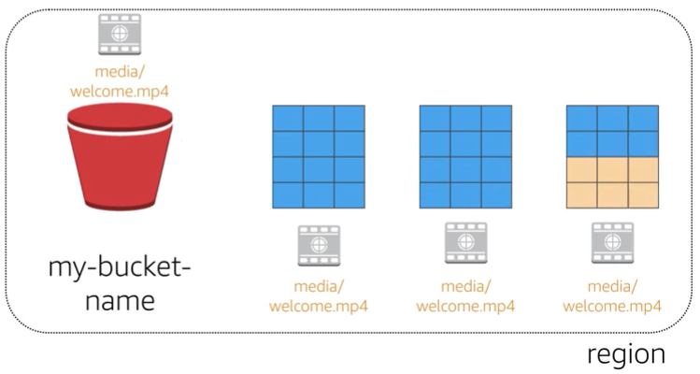

Data Redundantly Stored in Region
media/welcome.mp4
Facility 1
Facility 2
Facility 3
my-bucket-name
media/welcome.mp4
media/welcome.mp4
media/welcome.mp4
Region
Notes:
When you create a bucket in Amazon S3, it's associated with a particular AWS Region. Whenever you store data in the bucket, it is redundantly stored across multiple AWS facilities within your selected region.
Amazon S3 is designed to durably store your data, even in the case of concurrent data loss in two AWS facilities.

Slide 27
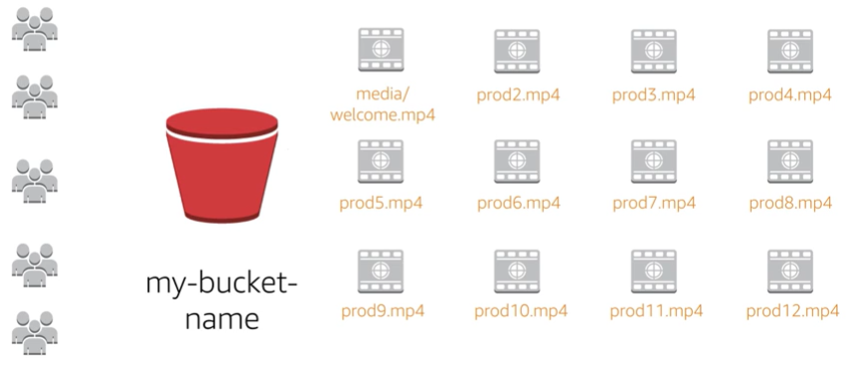
Designed for Seamless Scaling
media/welcome.mp4
prod2.mp4
prod3.mp4
prod4.mp4
prod5.mp4
prod6.mp4
prod7.mp4
prod8.mp4
my-bucket-name
prod9.mp4
prod10.mp4
prod11.mp4
prod12.mp4
Notes:
Amazon S3 will automatically manage the storage behind your bucket even as your data grows. This allows you to get started immediately and to have your data storage grow with your application needs.
Amazon S3 will also scale to handle a high volume of requests. You don't have to provision the storage or throughput, and you will only be billed for what you use.

Slide 28
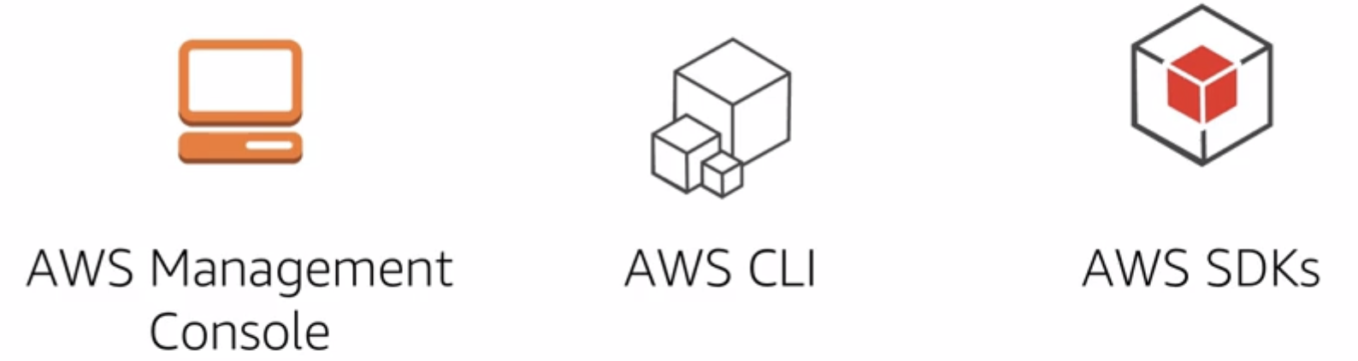
Access the Data Anywhere
Notes:
You can access Amazon S3 via the console, AWS CLI, or AWS SDK. Additionally, you can also access the data in your bucket directly via the rest endpoints.
These support HTTP or HTTPS access. To support this type of URL-based access, S3 bucket names must be globally unique and DNS-compliant.
Also, object keys should be using characters that are safe for URLs.

Slide 29

Common Use Cases
Storing application assets
Static web hosting
Backup and Disaster Recovery (DR)
Staging area for big data
Many more….
Notes:
This flexibility to store a virtually unlimited amount of data and access that data from anywhere makes Amazon S3 suitable for a wide range of scenarios. Let's look at some use cases for Amazon S3:
As a location for any application data, Amazon S3 buckets provide that shared location for storing objects that any instances of your application can access, including applications on Amazon EC2 or even traditional servers. This can be useful for user-generated media files, server logs, or other files your application needs to store in a common location. Also, because the content can be fetched directly over the web, you can offload serving of that content from your application and allow clients to directly fetch the data themselves from Amazon S3.
For static web hosting, Amazon S3 buckets can serve up the static contents of your website, including HTML, CSS, JavaScript, and other files.
The high durability of Amazon S3 makes it a good candidate to store backups of your data. For even greater availability and disaster recovery capability, Amazon S3 can even be configured to support cross-region replication such that data put into an Amazon S3 bucket in one region can be automatically replicated to another Amazon S3 region.
The scalable storage and performance of Amazon S3 make it a great candidate for staging or long-term storage of data you plan to analyze using a variety of big data tools. Given how simple it is to store and access data with Amazon S3, you'll find yourself using it frequently with AWS services and for other parts of your application.

Slide 30
Amazon S3 Pricing
Pay only for what you use, including:
GBs per month
Transfer OUT to other regions
PUT, COPY, POST, LIST, and GET requests
You do NOT have to pay for:
Transfers IN to Amazon S3.
Transfers OUT from Amazon S3 to Amazon CloudFront or Amazon EC2 in the same region.
Notes:
With Amazon S3, specific costs may vary depending on region and the specific requests made. You pay only for what you use, including gigabytes per month, transfer out of other regions, PUT, COPY, POST, LIST and GET requests. As a general rule, you only pay for transfers that cross the boundary of your region, which means you do not pay for transfers in to Amazon S3 and transfers out from Amazon S3 to Amazon CloudFront's edge locations within that same region.

Slide 31

Amazon S3: Storage Pricing
To estimate Amazon S3 costs, consider the following:
Types of storage classes:
Standard Storage
99.999999999% durability
99.99% availability
Standard-Infrequent Access (SIA)
99.999999999% durability
99.9% availability
Amount of storage:
The number and size of objects
Type of storage
Notes:
When you begin to estimate the costs of Amazon S3, you need to consider the following:
Storage Class:
Standard Storage is designed to provide 99.999999999% durability and 99.99% availability.
Standard – Infrequent Access (SIA) is a storage option within Amazon S3 that you can use to reduce your costs by storing less frequently accessed data at slightly lower levels of redundancy than Amazon S3’s standard storage. Standard – Infrequent Access is designed to provide the same 99.999999999% durability as Amazon S3 with 99.9% availability in a given year. It’s important to note that each class has different rates.
Storage – The number and size of objects stored in your Amazon S3 buckets as well as type of storage should also be considered.

Slide 32
Amazon S3: Storage Pricing
Requests:
The number of requests (GET, PUT, COPY):
Type of requests
Different rates for GET requests than other requests.
Data Transfer:
Pricing based on the amount of data transferred out of the Amazon S3 region
Data transfer in is free, but charges for data transfer out.
Notes:
Requests – Consider the number and type of requests. GET requests incur charges at different rates than other requests, such as PUT and COPY requests.
GET: Retrieves an object from Amazon S3. You must have READ access to use this operation.
PUT: Adds an object to a bucket. You must have WRITE permissions on a bucket to add an object to it.
COPY: Creates a copy of an object that is already stored in Amazon S3. A PUT copy operation is the same as performing a GET and then a PUT.
Data Transfer – Consider the amount of data transferred out of the Amazon S3 region. Remember that data transfer in is free, but there is a charge for data transfer out.

Slide 33
In Review
Amazon S3 is a fully managed cloud storage service.
Store a virtually unlimited number of objects.
Pay for only what you use.
Access at any time, from anywhere.
Amazon S3 offers rich security controls.
Notes:
We've covered an introduction to Amazon S3 including key features and some common use cases.
For more information about Amazon S3, select the link.
https://aws.amazon.com/s3/.

Slide 34
Amazon S3 Demo
Notes:
Please review the Amazon S3 demonstration: Amazon S3 Console Demo.
This video demonstration can be found in the learning management system.

Slide 35
Part 3: Amazon Elastic File System (Amazon EFS)
Notes:
Introducing Part 3: Amazon Elastic File System (or Amazon EFS).

Slide 36
Storage
Amazon Elastic File System (Amazon EFS)
Notes:
Amazon Elastic File System (Amazon EFS) provides simple, scalable, elastic file storage for use with AWS services and on-premises resources. It is easy to use and offers a simple interface that allows you to create and configure file systems quickly and easily.
Amazon EFS is built to elastically scale on demand without disrupting applications, growing and shrinking automatically as you add and remove files, so your applications have the storage they need, when they need it.

Slide 37
Amazon EFS Features
File storage in the AWS cloud
Perfect for big data and analytics, media processing workflows, content management, web serving and home directories
Petabyte-scale, low latency file system
Shared storage
Elastic capacity
Supports the Network File System versions 4.0 and 4.1 (NFSv4) protocol
Compatible with all Linux-based AMIs for Amazon EC2
Notes:
Amazon EFS is a fully managed service that makes it easy to set up and scale file storage in the AWS cloud. It is the easiest way to build a file system for big data and analytics, media processing workflows, content management, web serving and home directories.
You can create file systems that are accessible to Amazon EC2 instances via a file system interface (using standard operating system file I/O APIs) and that support full file system access semantics, such as strong consistency and file locking.
Amazon EFS file systems can automatically scale from gigabytes to petabytes of data without needing to provision storage. Thousands of Amazon EC2 instances can access an Amazon EFS file system at the same time, and Amazon EFS provides consistent performance to each Amazon EC2 instance. Amazon EFS is designed to be highly durable and highly available. With Amazon EFS, there is no minimum fee or setup costs, and you pay only for the storage you use.

Slide 38


Amazon EFS Architecture
Availability Zone A
Availability Zone B
Availability Zone C
NFS clients
EC2 Instance
EC2 Instance
EC2 Instance
NFS
Clients
NFS
Clients
Network
Interface
Network
Interface
Network
Interface
Subnet
Network
Interface
Mount
Target
Network
Interface
Mount
Target
Network
Interface
Mount
Target
Mount Target
Mount Target
Mount Target
Subnet
Subnet
Subnet
Amazon
EFS
Notes:
Amazon EFS provides file storage in the cloud. With Amazon EFS, you can create a file system, mount the file system on an Amazon EC2 instance, and then read and write data from to and from your file system. You can mount an Amazon EFS file system in your VPC, through the Network File System versions 4.0 and 4.1 (NFSv4) protocol.
You can access your Amazon EFS file system concurrently from Amazon EC2 instances in your Amazon VPC, so applications that scale beyond a single connection can access a file system. Amazon EC2 instances running in multiple Availability Zones within the same AWS Region can access the file system, so that many users can access and share a common data source.
In the illustration displayed, the VPC has three Availability Zones, and each has one mount target created in it. We recommend that you access the file system from a mount target within the same Availability Zone. Note that one of the Availability Zones has two subnets. However, a mount target is created in only one of the subnets.

Slide 39
Amazon EFS Implementation
1
Create your Amazon EC2 resources and launch your Amazon EC2 instance.
Create your Amazon EFS file system.
Create your target mounts in appropriate subnets.
Connect your Amazon EC2 instances to target mounts.
Clean up resources and protect your AWS account.
2
3
4
5
Notes:
There are five steps you need to perform to create and use your first Amazon EFS file system, mount it on an Amazon EC2 instance in your VPC, and test the end-to-end setup.
Create your Amazon EC2 resources and launch your instance. (Keep in mind that before you can launch and connect to an Amazon EC2 instance, you need to create a key pair, unless you already have one.)
Create your Amazon EFS file system.
In the appropriate subnet, create your target mounts.
Next, connect to your Amazon EC2 instance and mount the Amazon EFS file system.
Finally, clean up your resources and protect your AWS account.

Slide 40

Amazon EFS Resources
File system
Mount target
Subnet ID
Security groups
One or more per file system
Create in a VPC subnet
One per Availability Zone
Must be in the same VPC
Tags
Key-value pairs
Notes:
In Amazon EFS, a file system is the primary resource. Each file system has properties such as ID, creation token, creation time, file system size in bytes, number of mount targets created for the file system, and the file system state.
Amazon EFS also supports other resources to configure the primary resource. These include mount targets and tags.
Mount target: To access your file system, you must create mount targets in your VPC. Each mount target has the following properties:
The mount target ID
The subnet ID in which it is created
The file system ID for which it is created
An IP address at which the file system may be mounted
The mount target state.
You can use the Internet Protocol (IP) address or the Domain Name System (DNS) name in your mount command. Each file system has a DNS name of the following form.
Tags: To help organize your file systems, you can assign your own metadata to each of the file systems you create. Each tag is a key-value pair.
Think of mount targets and tags as sub-resources that do not exist without being associated with a file system.

Slide 41
Amazon EFS Review
Amazon EFS provides file storage over a network.
Perfect for big data and analytics, media processing workflows, content management, web serving and home directories.
Fully managed service that eliminates storage administration tasks.
Accessible from the console, an API, or the CLI.
Scales up or down as files are added or removed and you pay for what you use.
Notes:
We've covered an introduction to Amazon EFS, including key features and key resources. It provides file storage in the cloud that is perfect for big data and analytics, media processing workflows, content management, web serving and home directories.
Amazon EFS scales up or down as files are added or removed and you pay for only what you are using.
Amazon EFS is a fully managed service that is accessible from the console, an API, or the CLI.
For more information about Amazon S3, select the link.
https://aws.amazon.com/efs/.

Slide 42
Amazon EFS Demo
Notes:
Please review the Amazon EFS demonstration: Amazon Elastic File System (EFS) Console Demo.
This video demonstration can be found in the learning management system.

Slide 43
Part 4: Amazon Glacier
Notes:
Amazon Glacier is a secure, durable, and extremely low-cost cloud storage service for data archiving and long-term backup.

Slide 44

Storage
Amazon Glacier
Notes:
Let’s take a closer look at Amazon Glacier.

Slide 45
Amazon Glacier Review
Amazon Glacier is a data archiving service designed for security, durability, and an extremely low cost.
Designed for durability of 99.999999999% of objects.
Supports SSL/TLS encryption of data in transit and at rest.
The Vault Lock feature enforces compliance via a lockable policy.
Extremely low-cost design is ideal for long-term archiving.
Provides three options for access to archives (Expedited, Standard, and Bulk) from a few minutes to several hours.
Notes:
Amazon Glacier's data archiving means that although you can store your data at an extremely low cost (even in comparison to Amazon S3), you cannot retrieve your data immediately when you want it.
Data stored in Amazon Glacier takes several hours to retrieve, which is why it's ideal for archiving.
There are three key Amazon Glacier terms that you should be familiar with:
Archive: Any object such as a photo, video, file, or document that you store in Amazon Glacier. It is the base unit of storage in Amazon Glacier. Each archive has its own unique ID and can also have a description.
Vault: A container for storing archives. When you create a vault, you specify the vault name and the region in which you would like the vault located.
Vault Access Policy: Determine who can and cannot access the data stored in the vault as well as what operations users can and cannot perform. One vault access permissions policy can be created for each vault to manage access permissions for that vault. You can also use a vault lock policy to make sure a vault cannot be altered. Each vault can have one vault access policy and one vault lock policy attached to it.
There are three options for retrieving data with varying access times and cost: Expedited, Standard, and Bulk retrievals, as follows:
Expedited retrievals are typically made available within 1 – 5 minutes (highest cost).
Standard retrievals typically complete within 3 – 5 hours (less than expedited, more than bulk).
Bulk retrievals typically complete within 5 – 12 hours (lowest cost).
Think of it as being like choosing the cost to most economically ship a package.

Slide 46
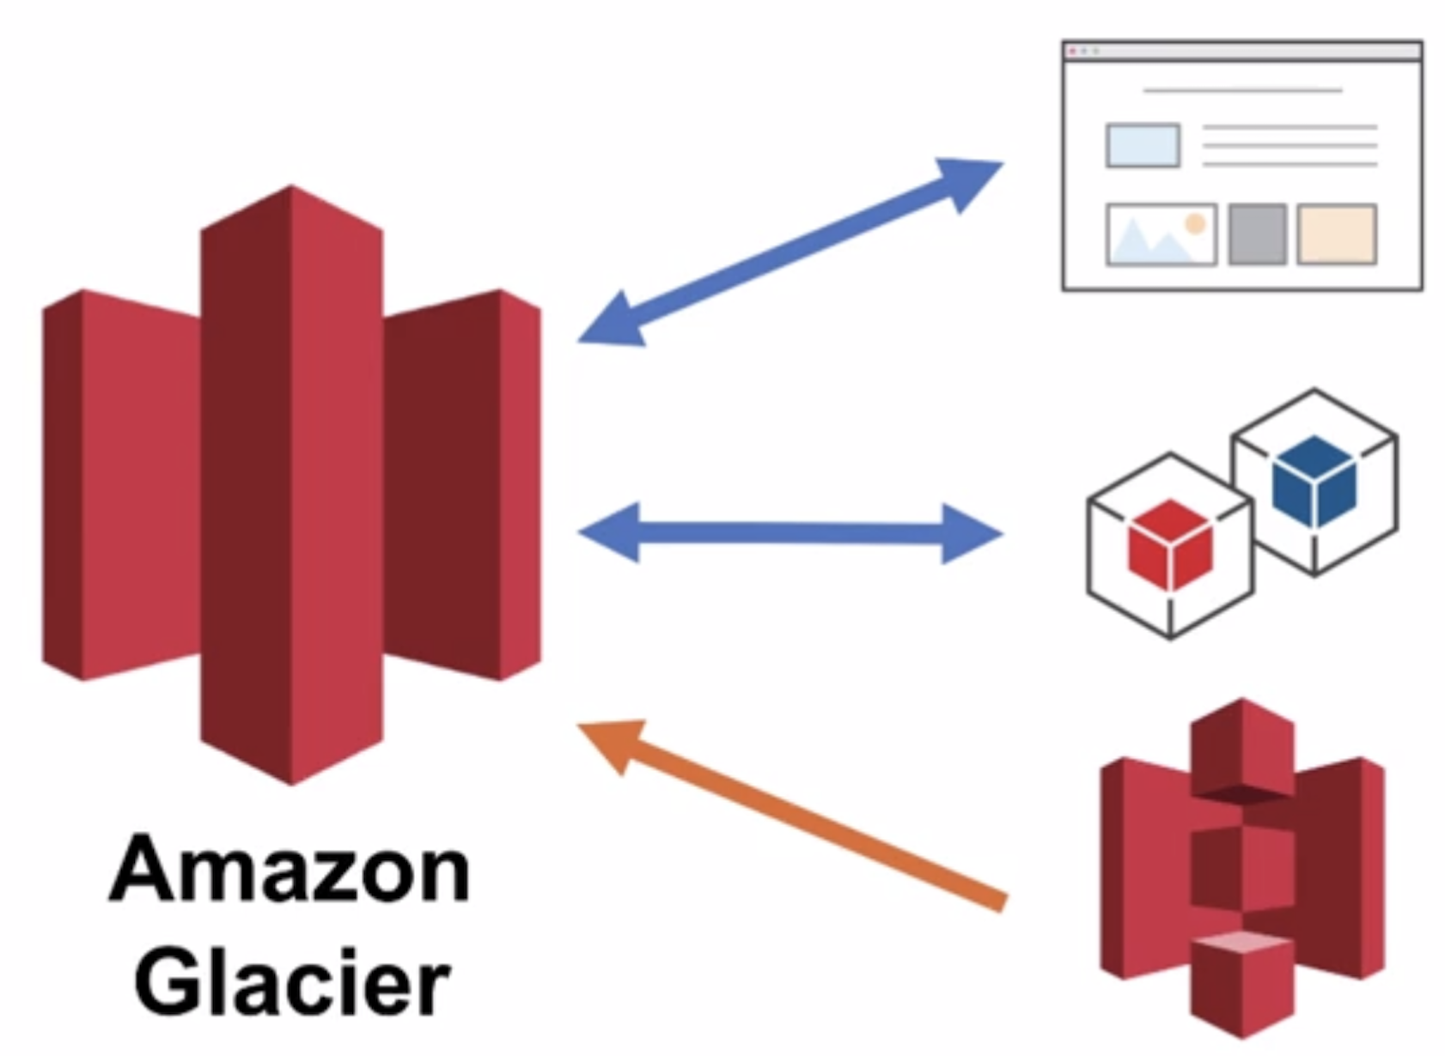
Using Amazon Glacier
RESTful
Web services
Java or .NET SDKs
Amazon S3 with lifecycle policies
Notes:
To store and access data in Amazon Glacier, you can use the AWS Management Console; however only a few operations, such as creating and deleting vaults and creating and managing archive policies, are available in the console.
Almost all other operations require that you use either the Amazon Glacier REST API, or AWS Java or .NET SDKs to interact with Amazon Glacier via the Command Line Interface (CLI).
You can also archive data into Amazon Glacier using lifecycle policies. Let’s take a closer look at what that means.

Slide 47


Lifecycle Policies
Amazon S3 lifecycle policies allow you to delete or move objects based on age.
Amazon S3 Standard
Amazon S3 Standard - Infrequent Access
Amazon
Glacier
Delete
30 Days
60 Days
365 Days
Preview2.mp4
Preview2.mp4
Preview2.mp4
Notes:
You should automate the lifecycle of your data stored in Amazon S3. Using lifecycle policies, you can have data cycled at regular intervals between different Amazon S3 storage types. This reduces your overall cost, because you are paying less for data as it becomes less important with time.
In addition to being able to set lifecycle rules per object, you can also set lifecycle rules per bucket.
Let’s take a look at an example of a lifecycle policy that moves data as it ages from Amazon S3 Standard to Amazon S3 Standard – Infrequent Access and, finally, into Amazon Glacier before it is deleted. Let’s say that the user uploads a video to your application and your application generates a thumbnail preview of the video. This video preview is stored to Amazon S3 Standard, because it is likely that the user will want to access it right away.
Your usage data indicates that most thumbnail previews are not accessed after 30 days. So, your lifecycle policy will take this previews and move them to Amazon S3 infrequent access after 30 days. Once another 30 days have lapsed, it is highly unlikely that it the preview will be accessed again, so it is moved to Amazon Glacier where it remains for 1 year. After one year, the preview is deleted. The important thing to note is that the lifecycle policy manages all of this movement automatically.
Select the link to learn more.
http://docs.aws.amazon.com/AmazonS3/latest/dev/object-lifecycle-mgmt.html.

Slide 48
Storage Comparison
 | Amazon S3 | Amazon Glacier
Data Volume | No limit | No limit
Average Latency | ms | min/hrs
Item Size | 5 TB max | 40 TB max
Cost/GB Per Month | ¢¢ | ¢
Billed Requests | PUT, COPY, POST, LIST, and GET | UPLOAD and retrieval
Retrieval Pricing | ¢ Per request | ¢¢ Per request and per GB
Notes:
While Amazon S3 and Amazon Glacier are both object storage solutions that allow you to store an unlimited amount of data, there are some critical differences between them that are outlined in this chart.
Be careful when deciding which storage solution is correct for your needs. These are two very different services for storage needs. Amazon S3 is designed for frequent, low-latency access to your data, while Amazon Glacier is designed for low-cost, long-term storage of infrequently accessed data.
The maximum item size in Amazon S3 is 5 TB, whereas Amazon Glacier can store items up to 40 TB in size.
Because Amazon S3 gives you faster access to your data, the storage cost per gigabyte is higher than it is with Amazon Glacier.
While both services have per request charges, Amazon S3 charges for PUT, COPY, POST, LIST, GET while Amazon Glacier charges for UPLOAD and retrieval.
Because Amazon Glacier was designed for less frequent access to data, it costs more for each retrieval request than Amazon S3. Both the cost per retrieval and the cost per GB are higher for Amazon Glacier.

Slide 49
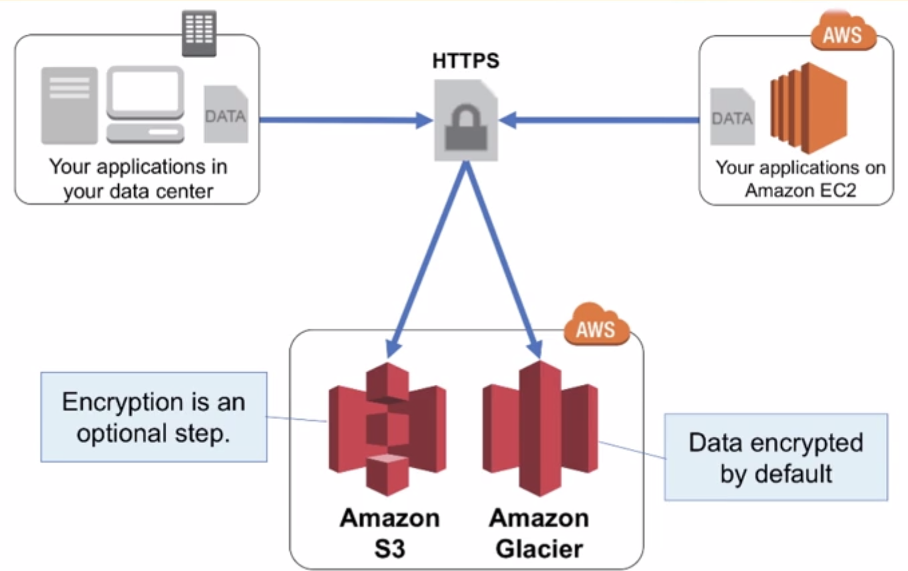
Server-Side Encryption
Notes:
Another important difference between Amazon S3 and Amazon Glacier is how data is encrypted. Server-side encryption is about protecting data at rest. With both solutions, you can securely transfer your data over HTTPS. Any data archived in Amazon Glacier is encrypted by default. With Amazon S3, your application must initiate server-side encryption. There are several ways to accomplish this:
Server-side encryption with Amazon S3-managed encryption keys (SSE-S3) employs strong multi-factor encryption. Amazon S3 encrypts each object with a unique key. As an additional safeguard, it encrypts the key itself with a master key that it regularly rotates. Amazon S3 server-side encryption uses one of the strongest block ciphers available, 256-bit Advanced Encryption Standard (AES-256), to encrypt your data.
AWS Key Management Service (AWS KMS) is a service that combines secure, highly available hardware and software to provide a key management system scaled for the cloud. AWS KMS uses Customer Master Keys (CMKs) to encrypt your Amazon S3 objects. You use AWS KMS via the Encryption Keys section in the IAM console or via AWS KMS APIs to centrally create encryption keys, define the policies that control how keys can be used, and audit key usage to prove they are being used correctly. You can use these keys to protect your data in Amazon S3 buckets.
Using server-side encryption with Customer-provided Encryption Keys (SS-EC) allows you to set your own encryption keys. With the encryption key you provide as part of your request, Amazon S3 manages both encryption, as it writes to disks, and decryption when you access your objects.

Slide 50

Security with Amazon Glacier
Control access with AWS IAM
Amazon Glacier encrypts your data with AES-256
Amazon Glacier
Amazon Glacier manages your keys for you
Notes:
By default, only you can access your data. You can enable and control access to your data in Amazon Glacier by using AWS IAM. You just set up an AWS IAM policy that specifies user access.

Slide 51
In Review
Amazon Glacier is a data archiving service designed for security, durability, and an extremely low cost.
Amazon Glacier pricing is region-based.
Extremely low-cost design is ideal for long-term archiving.
The service is designed for durability of 99.999999999% of objects.
Notes:
We've covered an introduction to Amazon Glacier including key differences between Amazon S3 and Amazon Glacier.
For more information about Amazon Glacier select the link.
https://aws.amazon.com/glacier/.

Slide 52
Amazon Glacier Demo
Notes:
Please review the Amazon Glacier demonstration: Amazon Glacier Console Demo.
This video demonstration can be accessed in the learning management system.

Slide 53

Section 2.0.2 Review:
Reviewed the characteristics of Amazon EBS, Amazon S3, Amazon EFS, and Amazon Glacier.
Identified appropriate uses for each storage options.
Briefly looked at the pricing difference for each storage option.
To finish this module:
Complete:
Knowledge Assessment
Notes:
In review, we:
Discussed storage services including Amazon EBS, Amazon S3, Amazon EFS, and Amazon Glacier.
Reviewed use cases for storage options.
Reviewed storage pricing.
To finish this module, please complete the lab and the corresponding knowledge assessment.

Slide 54
Up Next: Unit 2.03 – AWS Core Services - VPC
Notes:
Now that we have a better understanding some of the storage services offered by AWS, we’ll next look at Amazon Virtual Private Cloud (Amazon VPC). It lets you provision a logically isolated section of the AWS Cloud where you can launch AWS resources in a virtual network that you define.

Slide 55
Thanks for participating!
© 2018 Amazon Web Services, Inc. or its affiliates. All rights reserved. This work may not be reproduced or redistributed, in whole or in part, without prior written permission from Amazon Web Services, Inc. Commercial copying, lending, or selling is prohibited. Corrections or feedback on the course, please email us at: aws-course-feedback@amazon.com. For all other questions, contact us at: https://aws.amazon.com/contact-us/aws-training/. All trademarks are the property of their owners.
Notes:
Thanks for participating.

